Slide 1
MapReduce 1.0
Jay Urbain, PhD

Slide 2
MapReduce
Programming paradigm
Originally created at Google
MapReduce: Simplified Data Processing on Large Clusters, Jeffrey Dean and Sanjay Ghemawat
https://research.google.com/archive/mapreduce.html
Designed to solve a single problem: how to index the Internet!
Basically two parts:
Map
Reduce

Slide 3
MapReduce
Map(key, value)
Execute the Map(key, value) function to transform data
Execute on each node
If node goes, its restarted on another node
Bring computation to data versus bringing the data to the computation.
Output(key’, value’) pairs on each node
Reduce(key’, value’*)
Execute the Reduce() function to aggregate data output from mapper
Executes on some of the nodes
Output(key’’, value’’*) combined list

Slide 4
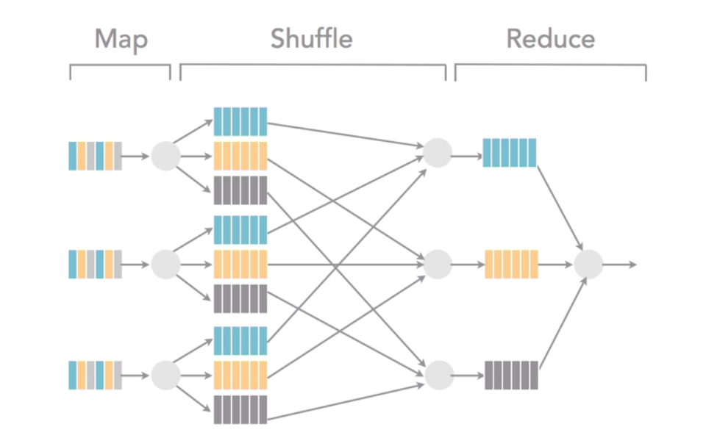
Notes:
Programmer provides Map and Reduce functions
Data is sorted as part of shuffle step to reducer
Shuffle step provided by the framework
Colors show different types of data
Shows 3 Map nodes on 3 separate physical servers
Does not show x3 replication

Slide 5
MapReduce 1.0
Distributed, scalable, inexpensive – runs on commodity hardware
Lends itself to parallel processing, runs on each node, no shared data
MapReduce 2.0/YARN builds on MapReduce 1.0
Use MRv2 for new development
Storage
HDFS – triple replicated
Commodity hardware
Processing
Parallel via Map (local) and Reduce (aggregated)
Relatively easy to understand

Slide 6
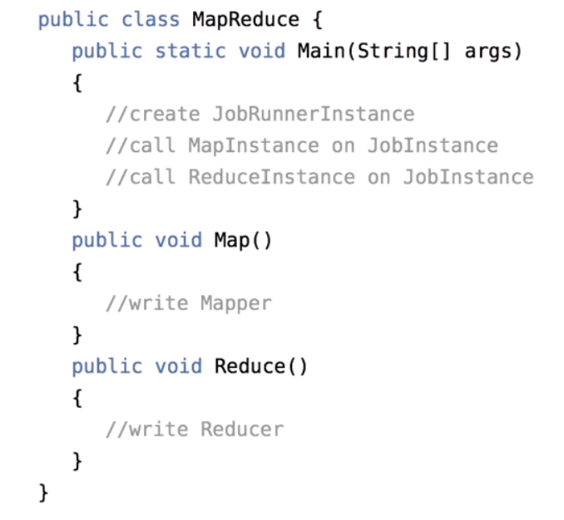
Coding Steps
Create a MapReduce class
Create a static Map function
Transform function
Create a static Reduce function
Aggregation function
Create a main() function
Create a job
Job calls the Map and Reduce classes
Programming paradigm:
Functional programming: data/state is not shared, data in, data out
The equivalent of a complex SQL query has to be broken into multiple steps/jobs/applications

Slide 7
Word count: Hello World for MapReduce - Google needed to count the number of words on the web for indexing
Example:
How much wood could a woodchuck chuck if a woodchuck could chuck wood?
Input:
List of words (example above)
Result:
{how, 1; much, 1; wood, 2; could, 2; a, 2; woodchuck,2; chuck, 2; if,1}
Question:
What is a word? Case sensitivity, punctuation, stemming, etc.

Slide 8
Word Count Pseudo Code Need to look at code with respect to correctness and performance
map(filename, file-contents)
for each word in file-contents
emit(word, 1)
reduce(word, values)
sum = 0
for each value in values:
sum += value
emit(word, sum)

Slide 9
Key Aspects of MapReduce
MapReduce is an API, set of libraries (jar files)
Job – unit of MapReduce work/instance
Map task – runs on each node
Reduce task – runs on some nodes
Source data – HDFS or other location

Slide 10
MapReduce Daemons and Services
JVMs or services – isolated processes, no shared state
Job tracker – one (controller and scheduler)
Task trackers – one per cluster host (monitors tasks)
Job configurations
Specify input/output locations for job instances
Job clients submit jobs for execution – Use GUI, command line, etc.

Slide 11
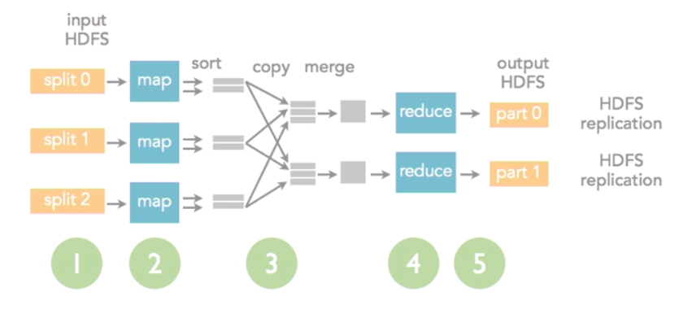
MapReduce
Sort and merge have defaults, but can be overridden
Input split, number of mappers and reducers are configurable

Slide 12
MapReduce Coding Patterns
Standard – usually written in Java
Hadoop Streaming – Java base
Other language for mapper/reducer logic
Python popular, can use almost anything

Slide 13
Running MapReduce Job
Can run in IDE, tool, or command line
Eclipse and Hadoop SDKs – included with Cloudera and Hortonworks distribution
File system or HDFS or S3
MapReduce output: SUCCESS, series of delimited text files. Note:
Immutable if stored in HDFS
Will not allow you to overwrite or update existing files
Each run needs a new file name or old files to be removed
Usually appends run time to file name for uniqueness

Slide 14
MapReduce Job Status and Logs
Monitor job run status
Command line
Tools in vendor distribution
Log files
Troubleshooting failed jobs requires programming and admin skills
Error logs – much more verbose than RDBMS systems, can adjust level of logging

Slide 15
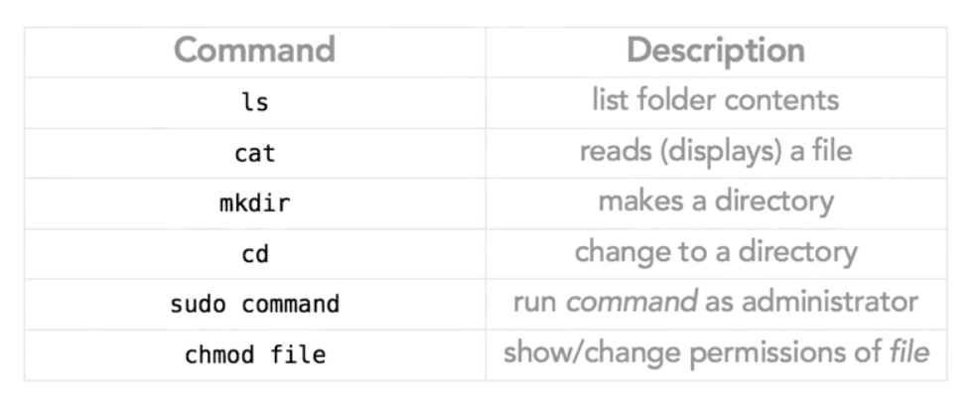
Linux Shell Commands
Hint: Use tab to complete commands

Slide 16
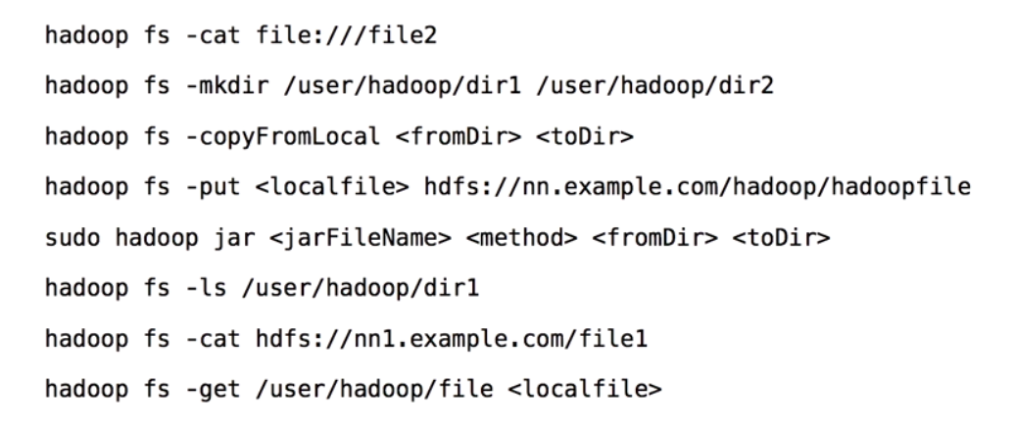
Hadoop Shell Commands
Notes:
Some installations use dfs rather than fs
Old style uses hdfs rather than hadoop

Slide 17
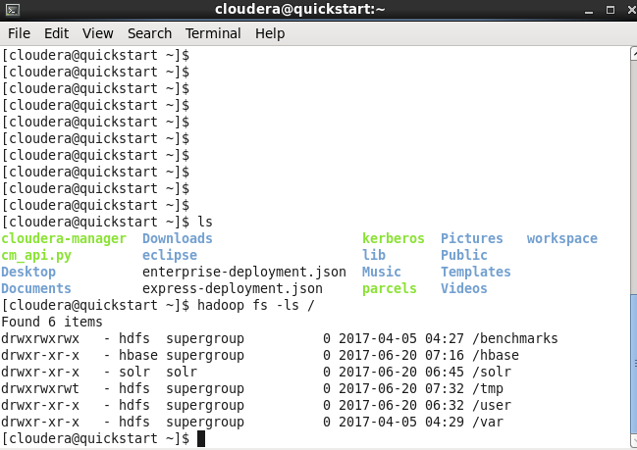
Cloudera VM Terminal

Slide 18
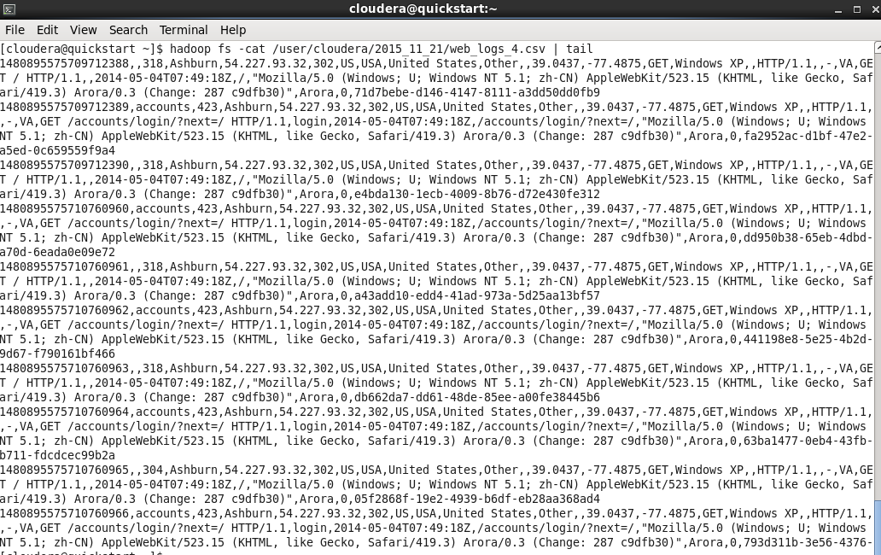
Cloudera VM Terminal: head|tail Handy for huge files

Slide 19
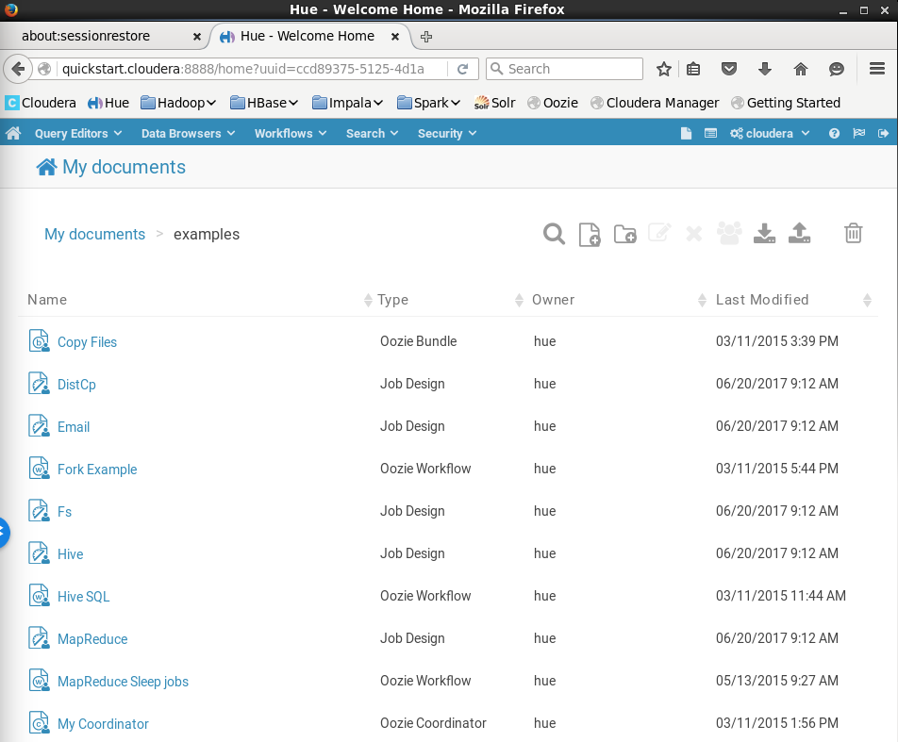
Hue Home – jobs Select MapReduce Sleep Jobs

Slide 20
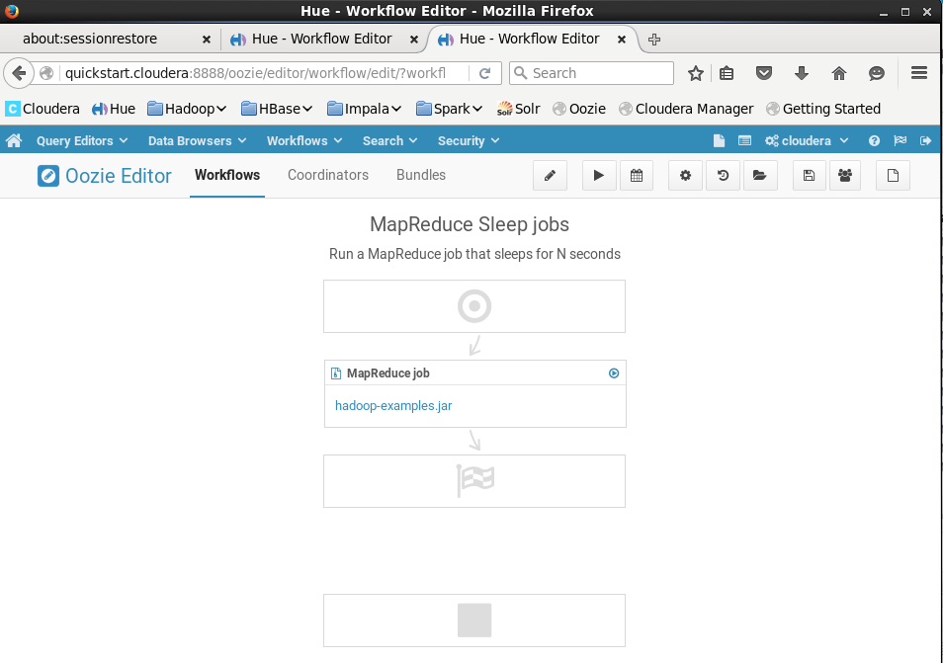
Oozie Workflow

Slide 21
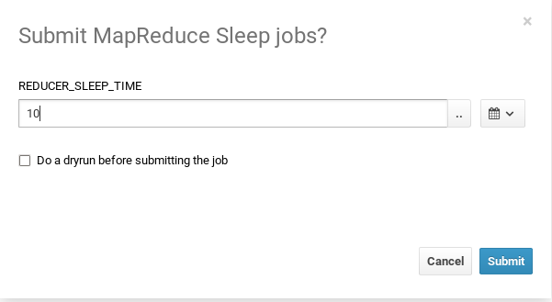
Application Counts words then sleeps

Slide 22
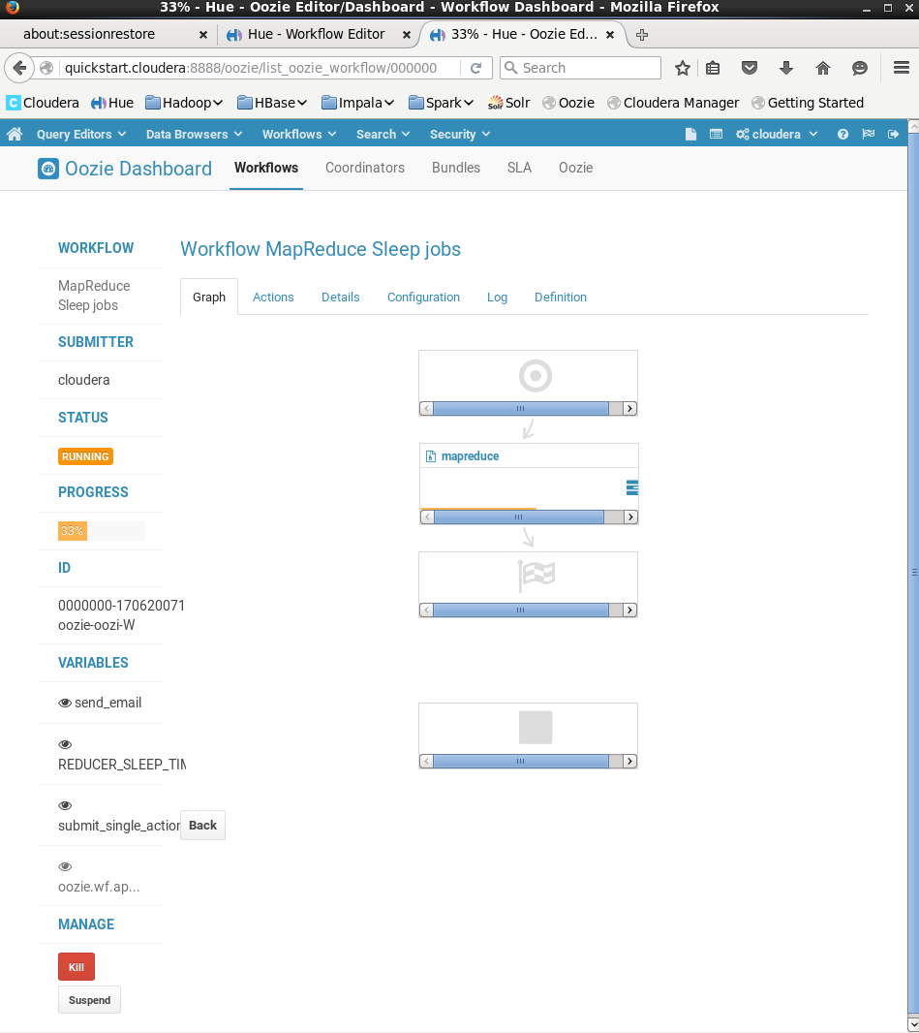
All jobs
Have an ID

Slide 23
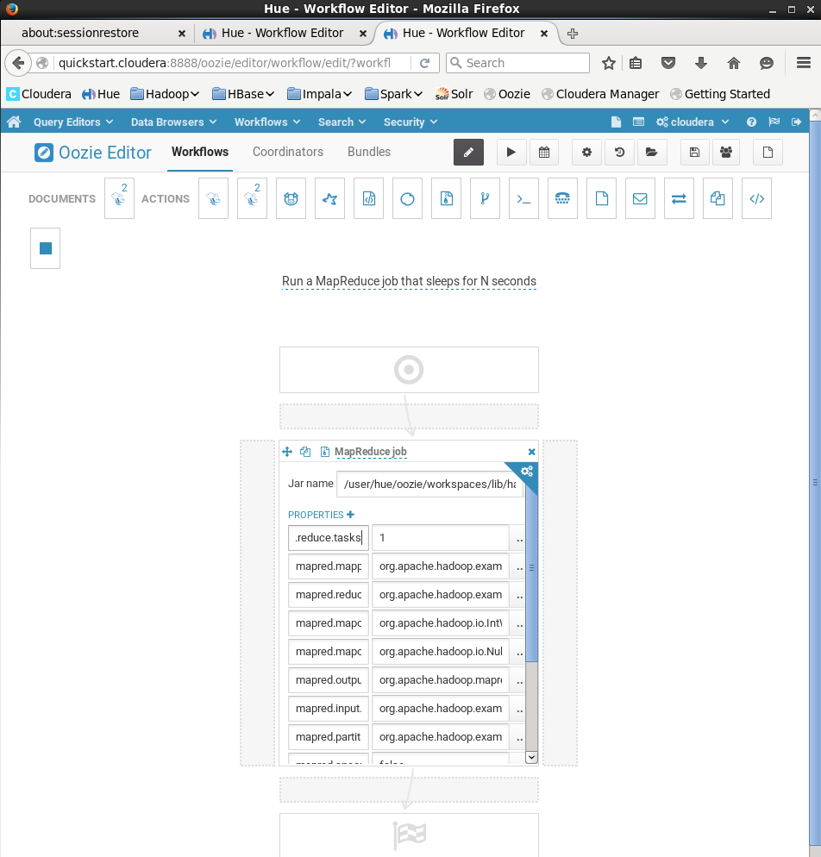
Edit Properties

Slide 24
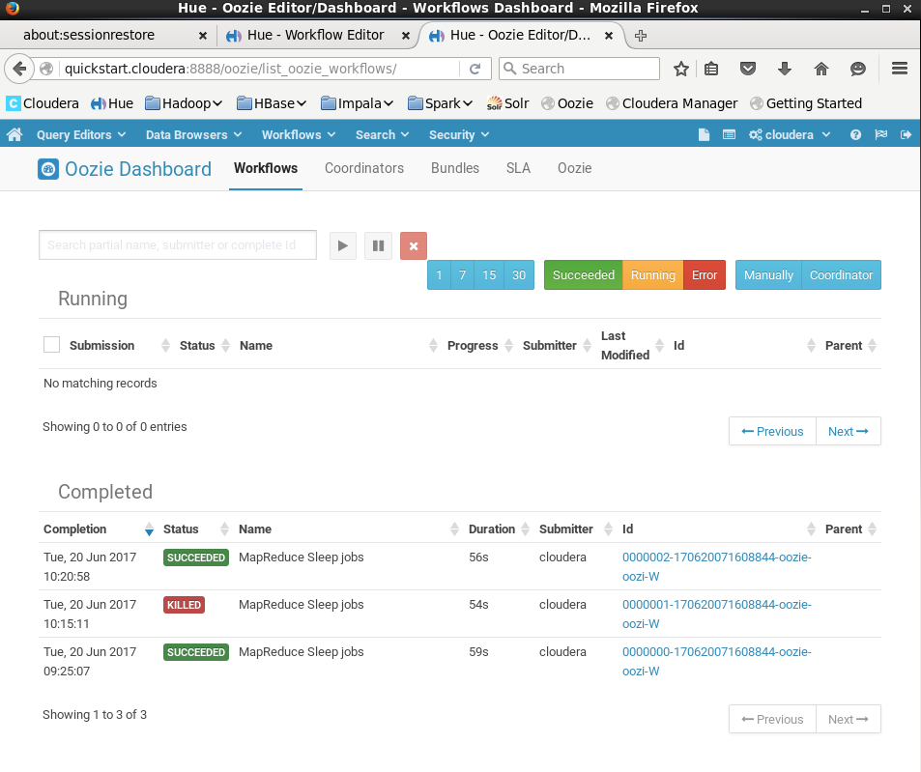
Oozie Dashboard – Job Status

Slide 25
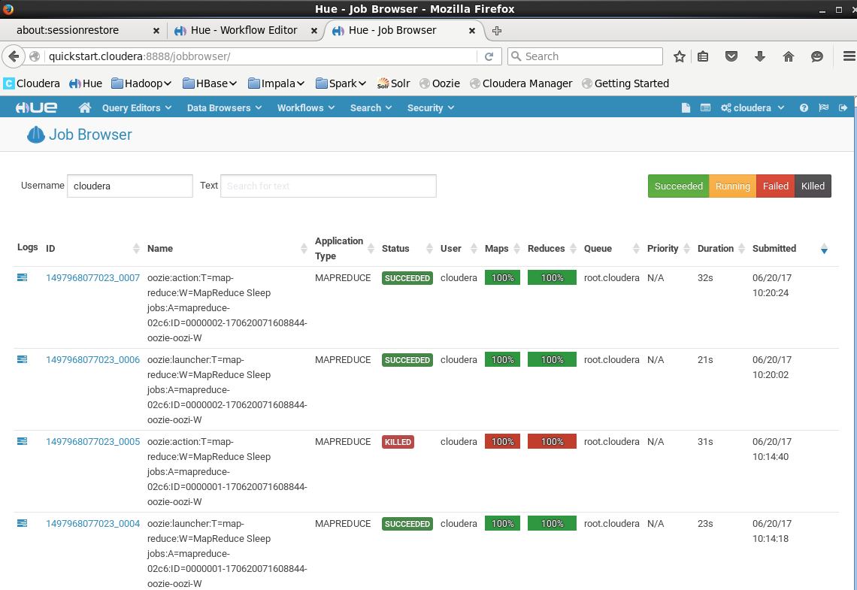
Job Browser (via logs view)

Slide 26
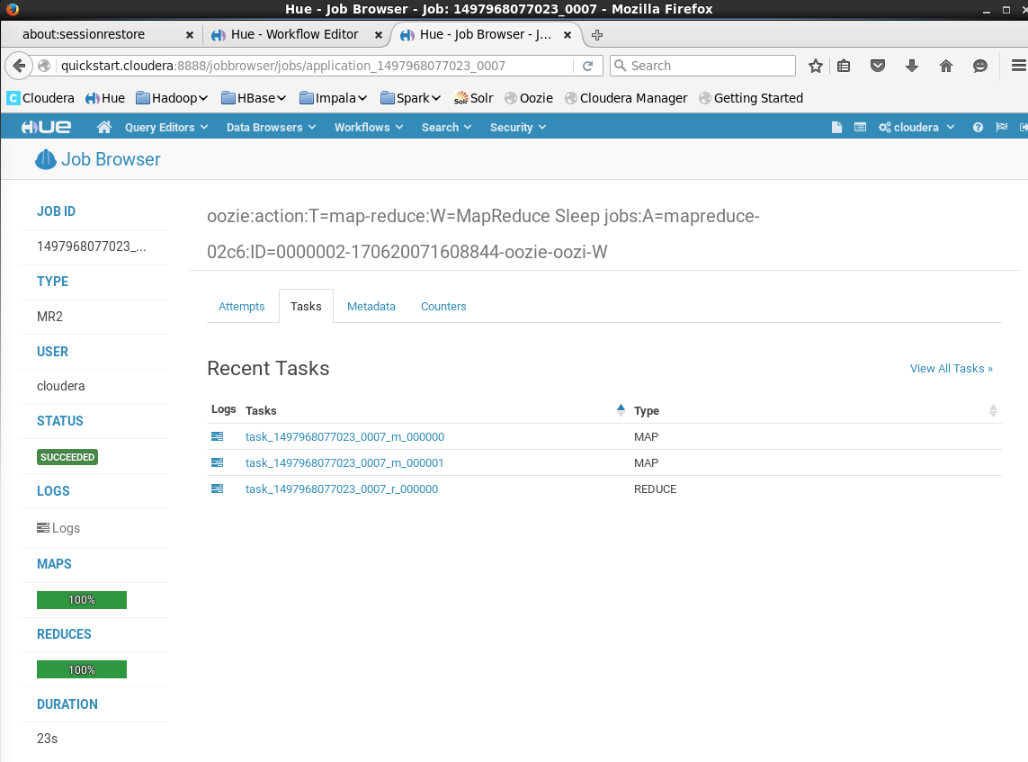
Tasks

Slide 27
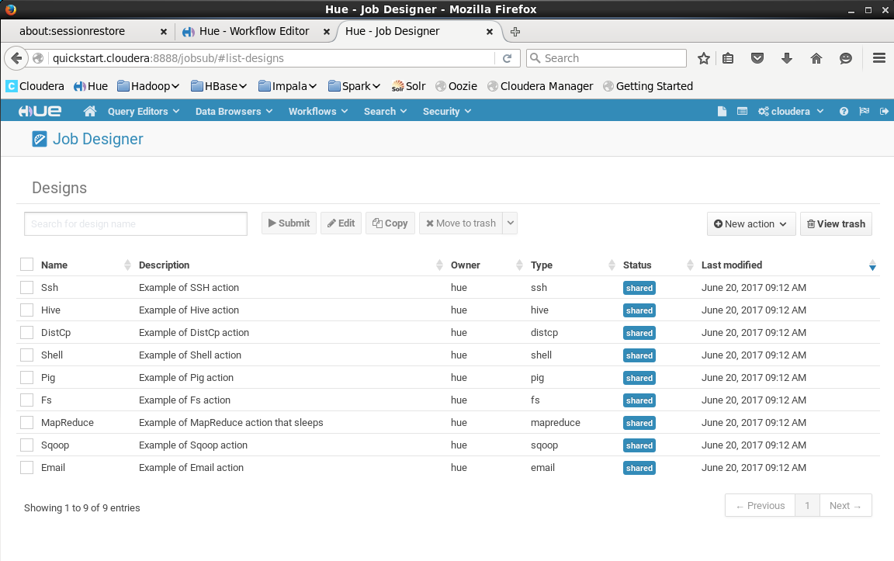
Design Your Own Project – Hue -> Query Editor -> Job Designer

Slide 28
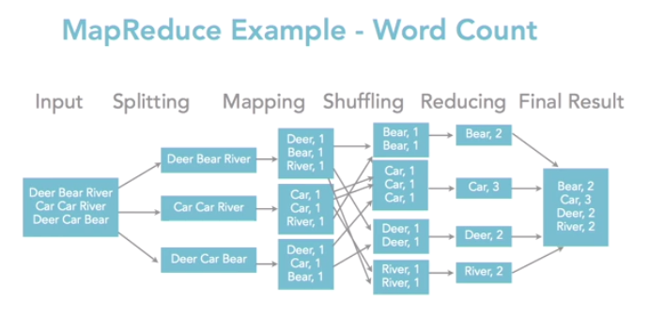
MapReduce Word Count Example
Developers focus on map and reduce, can override defaults

Slide 29
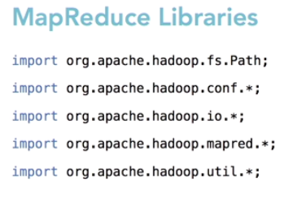
MapReduce API Versions
Version 1.0
org.apache.hadoop.mapred
Version 2.0
org.apache.hadoop.mapreduce

Slide 30
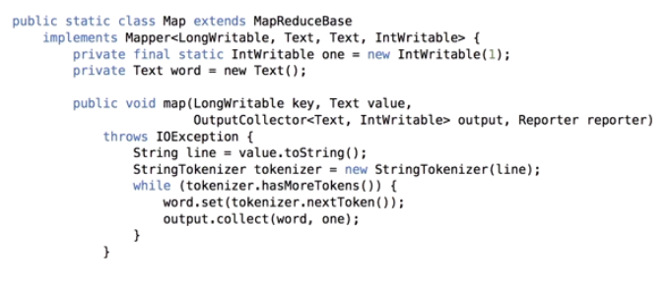
MapReduce Mapper Code (Version 1)

Slide 31
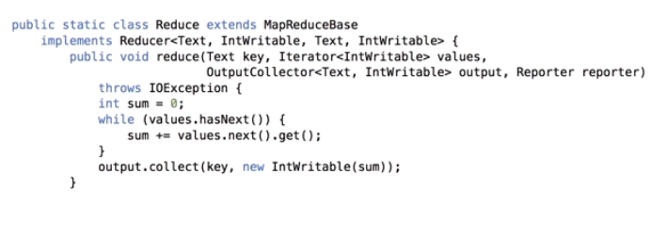
MapReduce Reducer Code
// aggregation

Slide 32
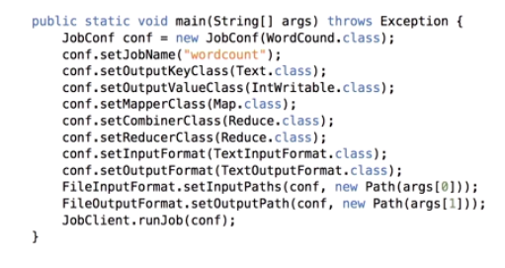
MapReduce Job Main
// adds up values on each node before network shuffle

Slide 33
Key Components
Input/output (data)
Writable/write comparable
Mapper
Maps input key/value pairs to a set of intermediate key/value pairs.
Reducer
Reduces a set of intermediate values which share a key to a smaller set of values.
Partitioner
Controls the partitioning of the keys of the intermediate map-outputs.
Reporter
A facility for reporting progress and update counters, status information etc.
OutputCollector
Collect data output by either the Mapper or the Reducer i.e. intermediate outputs or the output of the job.

Slide 34
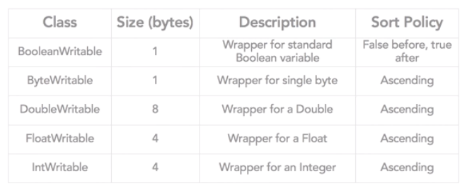
Writable Data Types
Note: Can also write custom writable data type

Slide 35
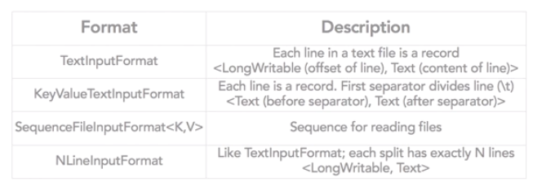
Input Types
SequenceFileInputFormat: Serialized binary files,
different formats and compression available

Slide 36
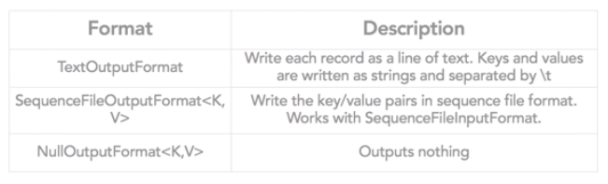
Output Types

Slide 37
Running and tracking Hadoop Jobs
Configure JobConf options
From the development environment (IDE)
From a GUI (Hue / HDInsight console)
From the command line:
hadoop jar filename.jar input output

Slide 38
Job Execution Optimizations
Speculative execution
kills long-running jobs, and (tries) restarts
Based on configuration parameters

Slide 39
Methods to write MapReduce Jobs
Standard – usually written in Java
Streaming (Python common)
Pipes (C++ common)
Abstraction libraries
Hive, Pig, et. (higher-level language)
Generate MapReduce jobs

Slide 40
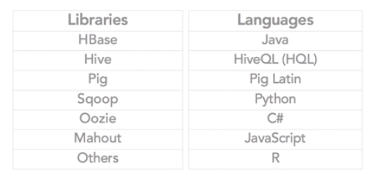
Ways to use MapReduce Need to determine what level of abstraction you want to work at Java gives you a lot of control

Slide 41
Review
Which of the following are key aspects of MapReduce Version 1?
It is extremely distributed, scalable, and cheap
It is resilient because if one of the nodes goes down, HDFS is self-healing
It really lends itself to parallel processing
All of the answers
Which of the following terminal commands will read the contents of a file from the loal file system?
hadoop fs –cat file:///file2
hadoop fs –cat hdfs:///file1
hadoop fs –get /user/hadoop/file <localfile>
hadoop fs –copyFromLocal <fromDir> <toDir>

Slide 42
Review
If you’re using HDFS in addition to MapReduce API, you’re going to have some core libraries that you need. Which of the following is a core library?
All of these answers
org.apache.hadoop.io.*
org.apache.hadoop.conf.*
org.apache.fs.Path.*
Which of the following is not a method to write MapReduce Job?
Standard – usually Java
Streaming paradigm
Pipes
JobConf

